Slide 1
MULTI-CUT REBAR(11)
Advisor : Prof. K.C.Chang
Presenters : You-Ran Nai
Notes:
試試看暫停一下

Slide 2
TAP010

Slide 3
TAP032

Slide 4
TAP052

Slide 5
Outline
1
2
3
4
5
Load Pattern
IDA vs Pushover
Nonlinear Hinge
GUI Progress
Roadmap
Notes:
Pushover mode load pattern
Time history inertia force vs mode shape
Ida vs pushover
Pushover nonlinear hinge
GUI progress
Roadmap

Slide 6
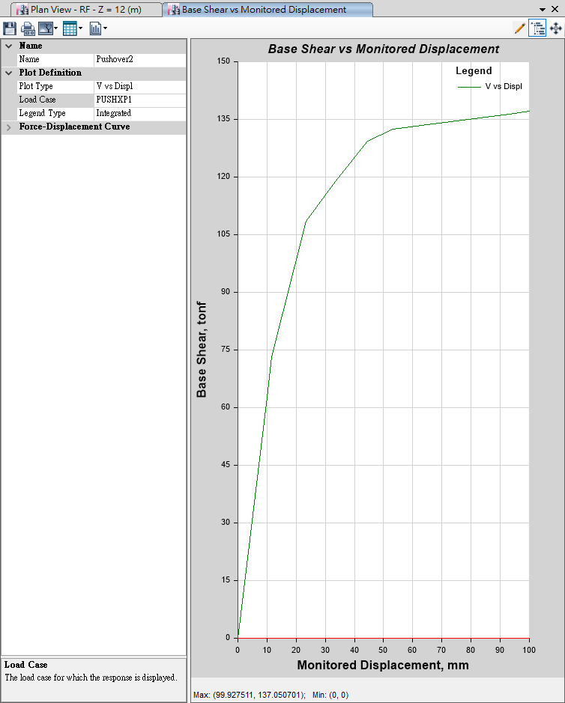
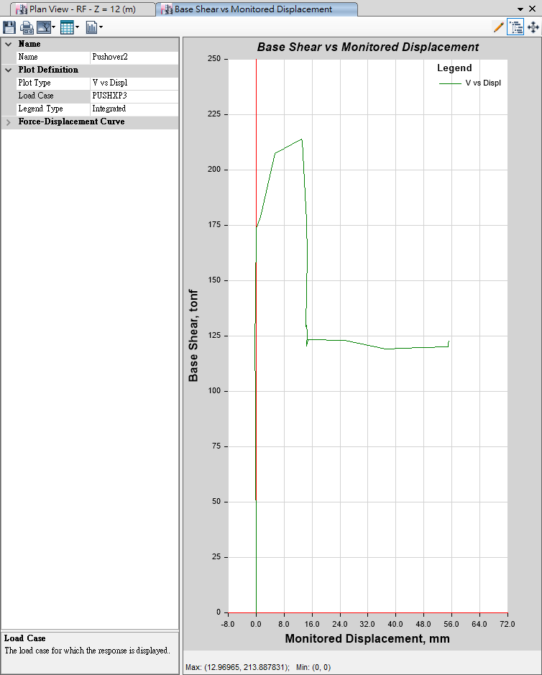
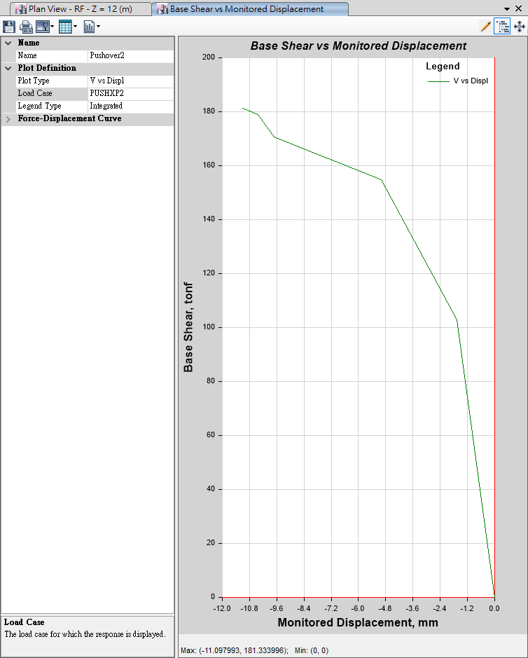
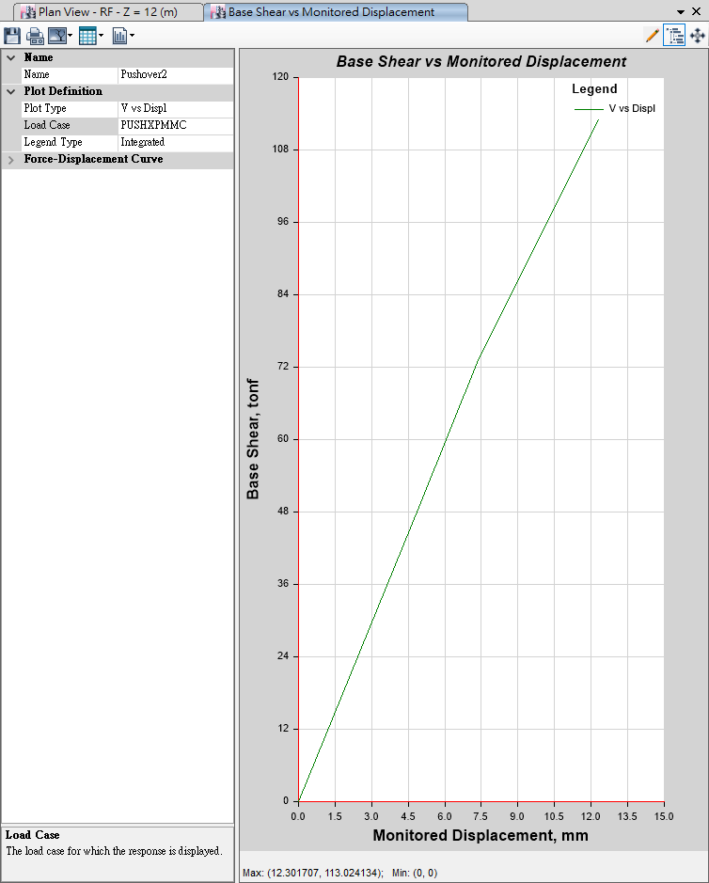
Pushover
Mode 1
Mode 3
100mm
10mm
User Defined
Mode 2
MMC
10mm
10mm

Slide 7
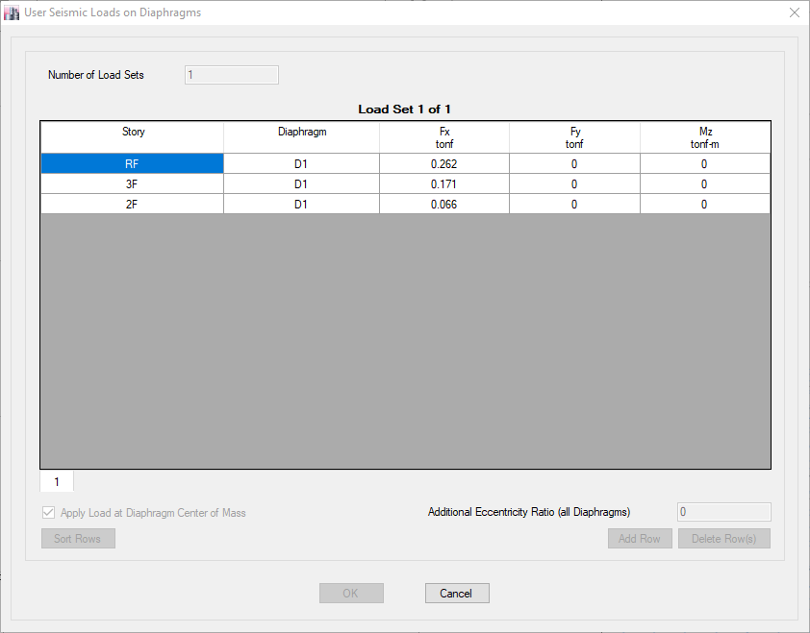
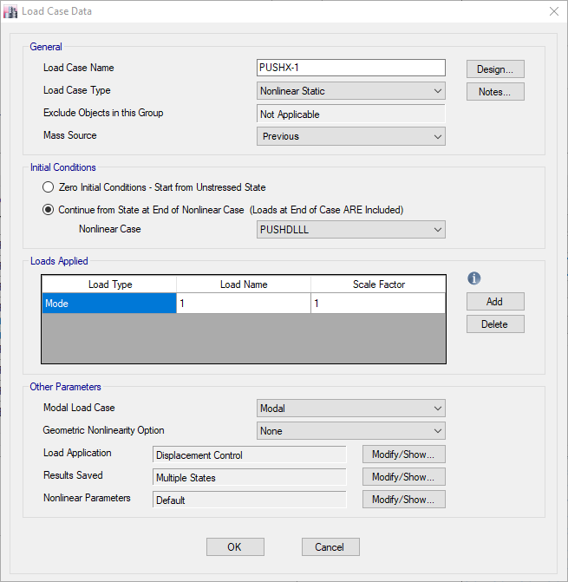

Auto Generate Mode
User Defined Mode

Slide 8
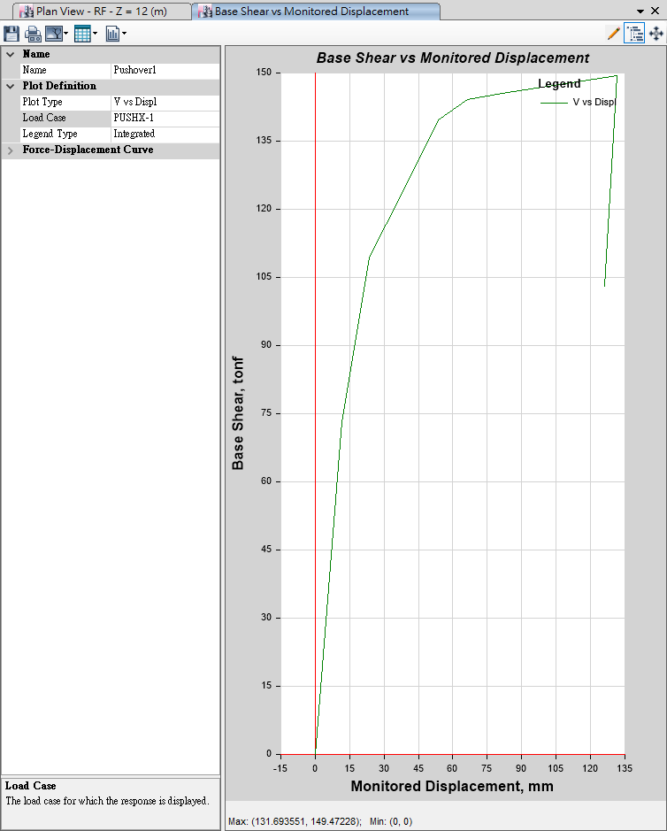
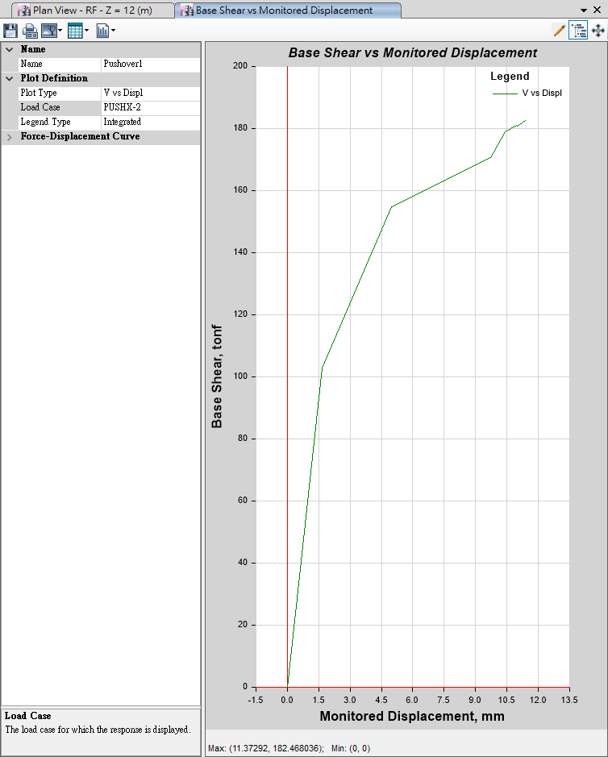
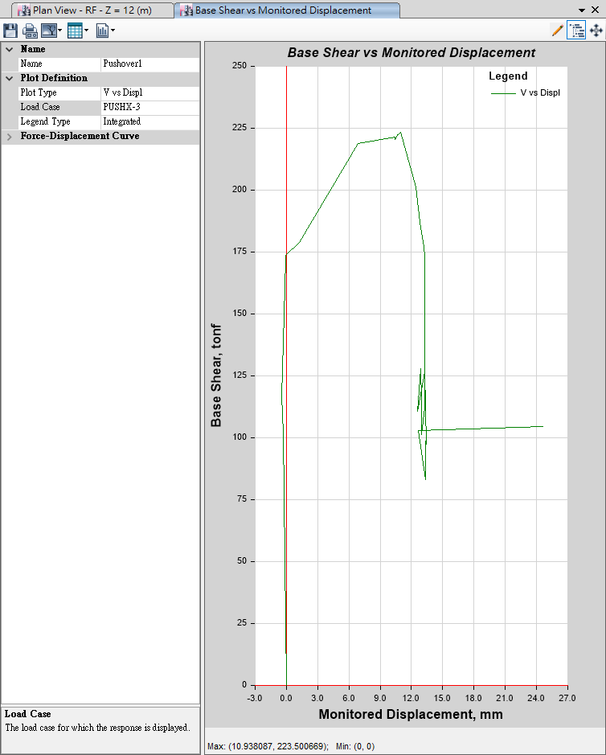
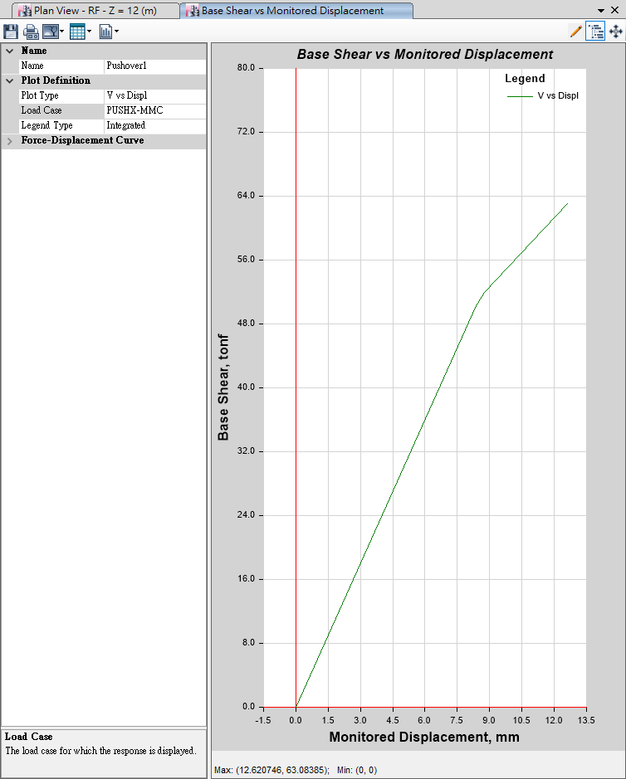
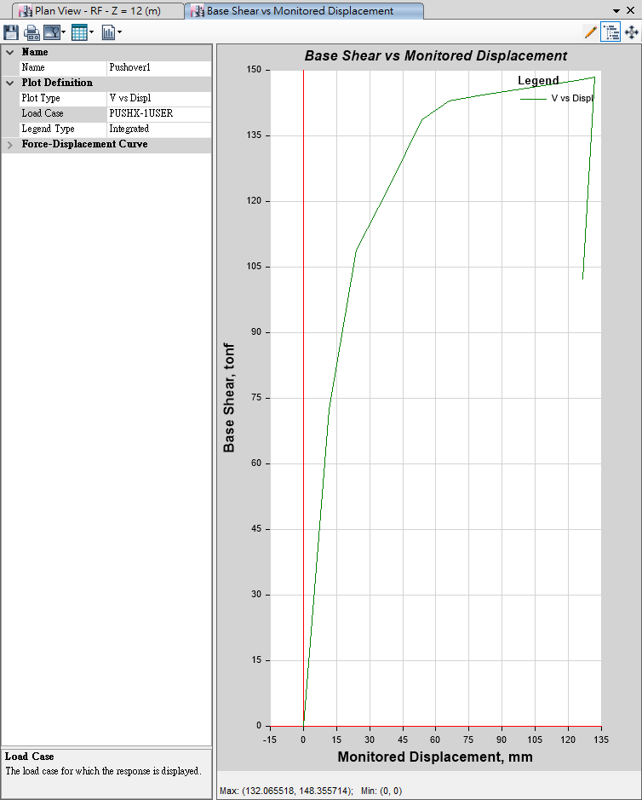
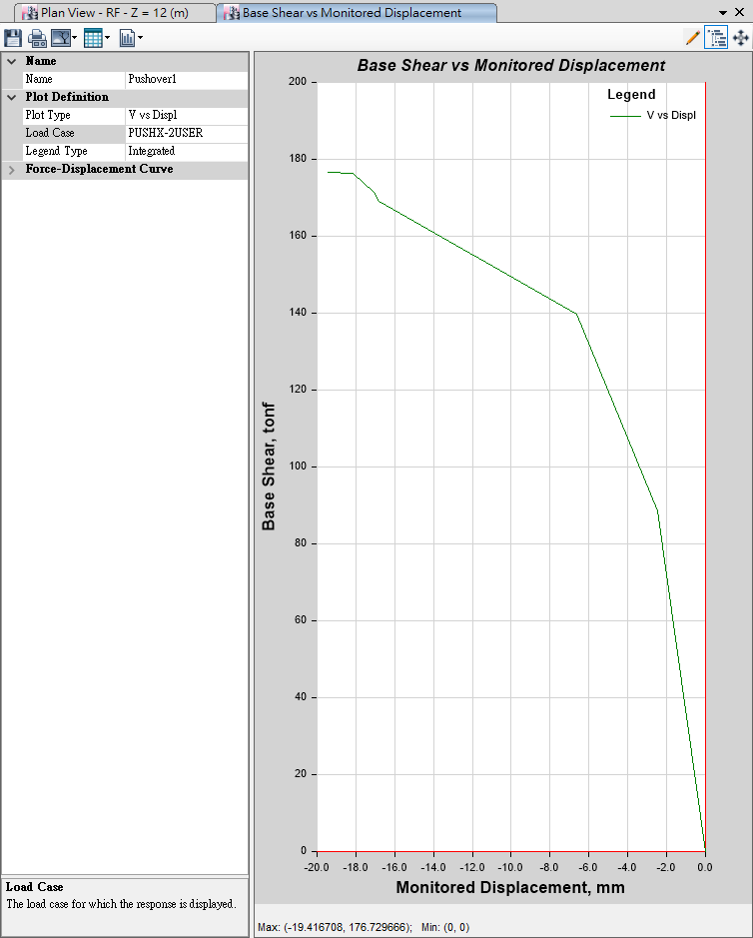
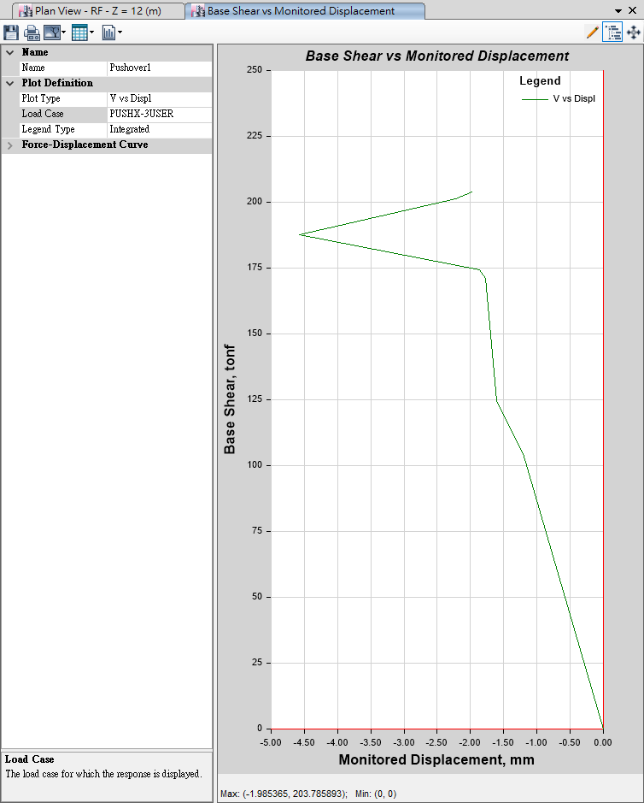

Auto
Generate
Mode
Mode 1
135mm
Mode 2
13mm
Mode 3
27mm
-MMC-
13mm
User Defined
User
Defined
Mode
Mode 1
135mm
Mode 2
20mm
Mode 3
5mm
-MMC-
150mm

Slide 9
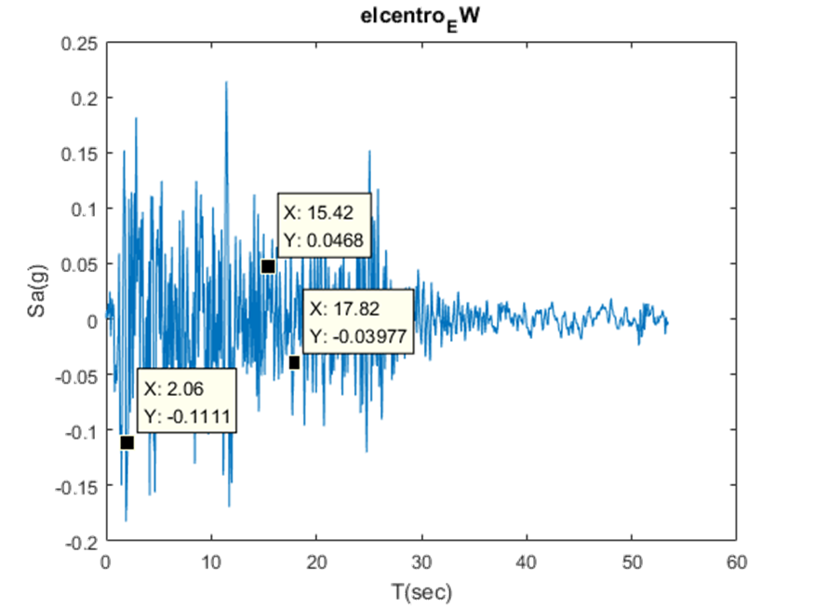
Inertia Force

Slide 10
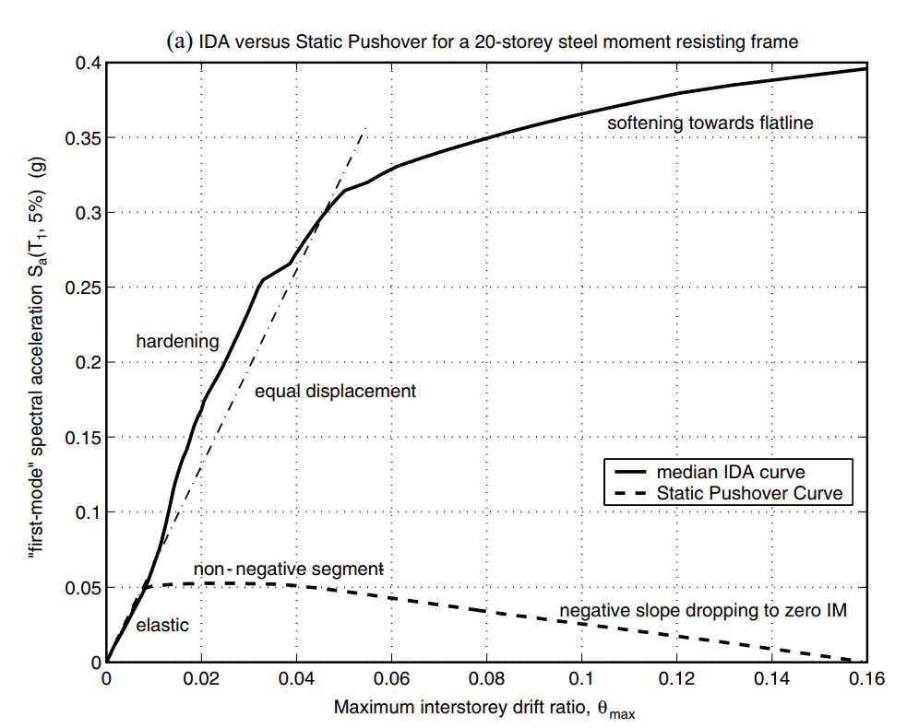
NON-LINEAR SPO
ELASTIC
➔
MATCH
NON-NEGATIVE
➔
EQUAL DISPLACEMENT
NEGATIVE
➔
SOFTENING

Slide 11
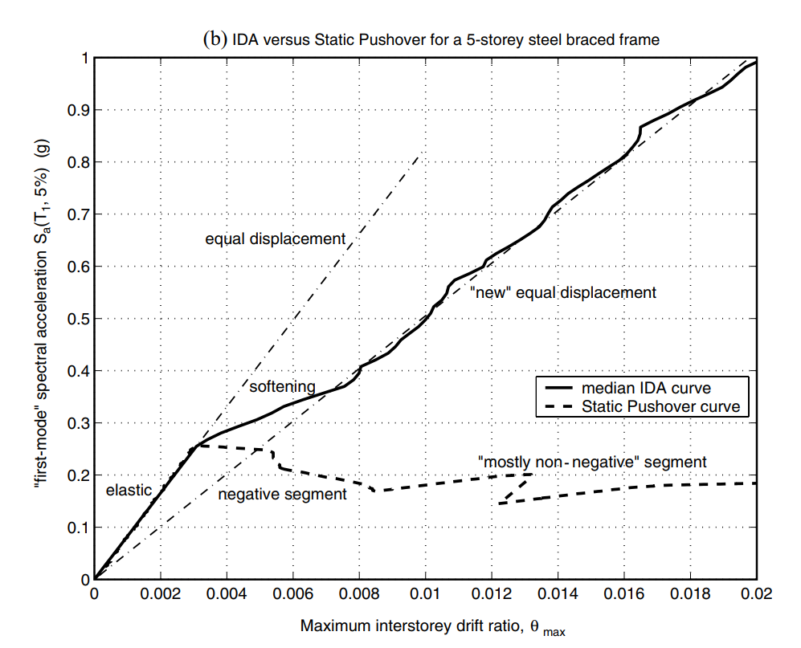
NON-LINEAR SPO
NEGATIVE => NON-NEGATIVE
NEW
EQUAL DISPLACEMENT
➔

Slide 12
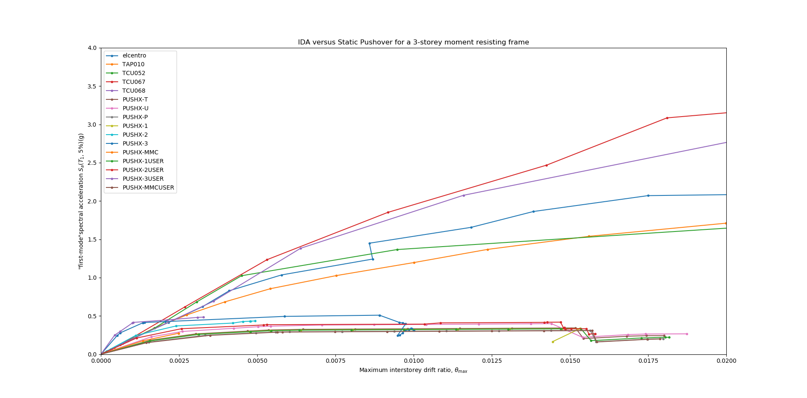

Slide 13
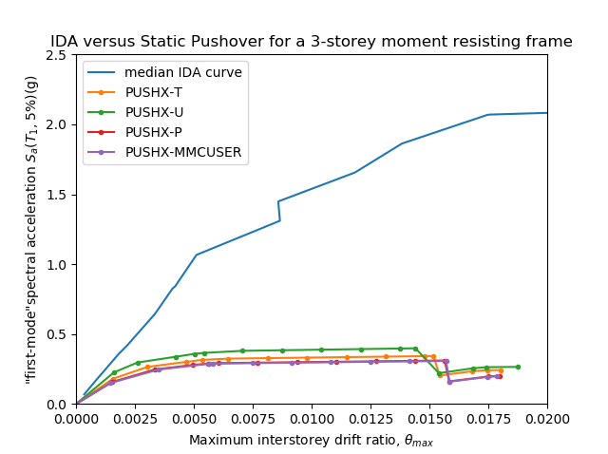
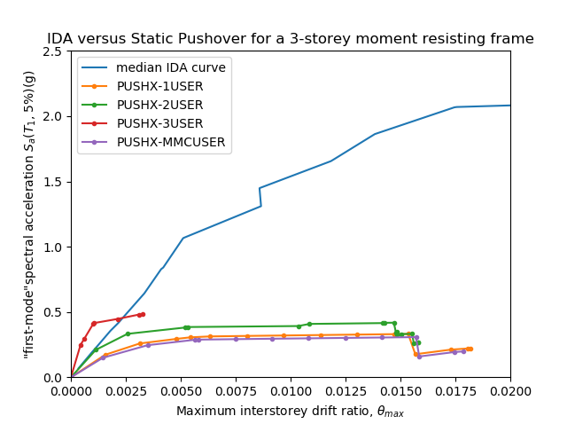
IDA vs Pushover

Slide 14
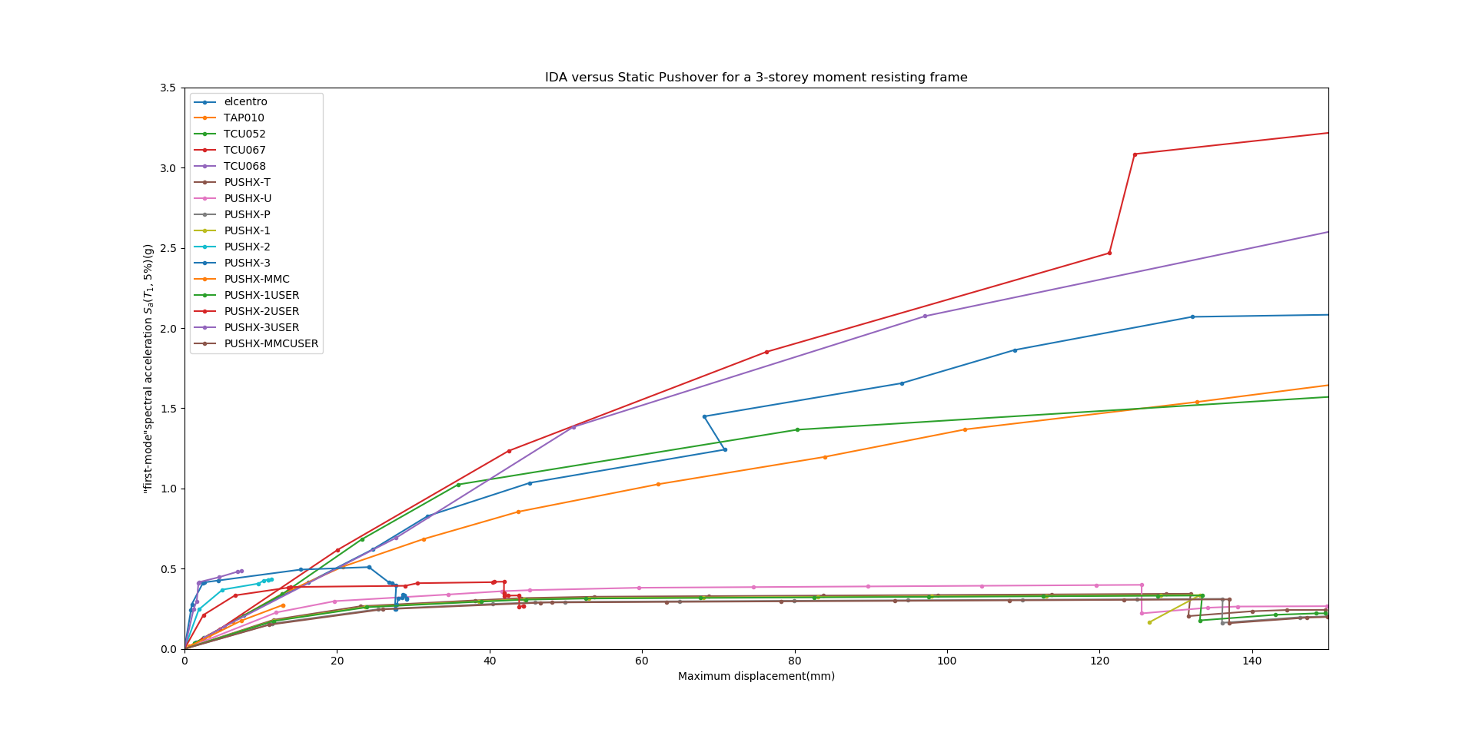
Displacement

Slide 15
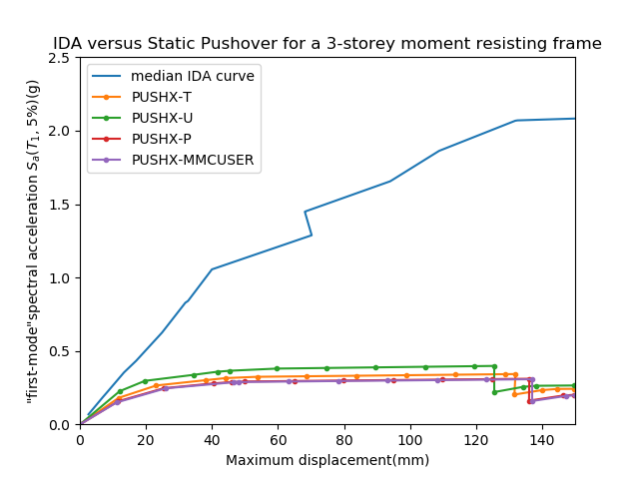
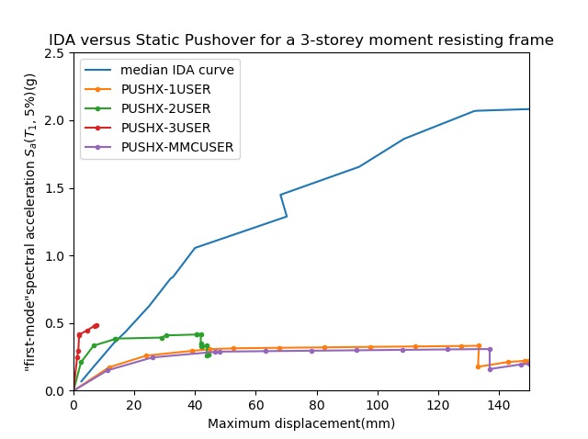
IDA vs Pushover
Displacement
Displacement

Slide 16
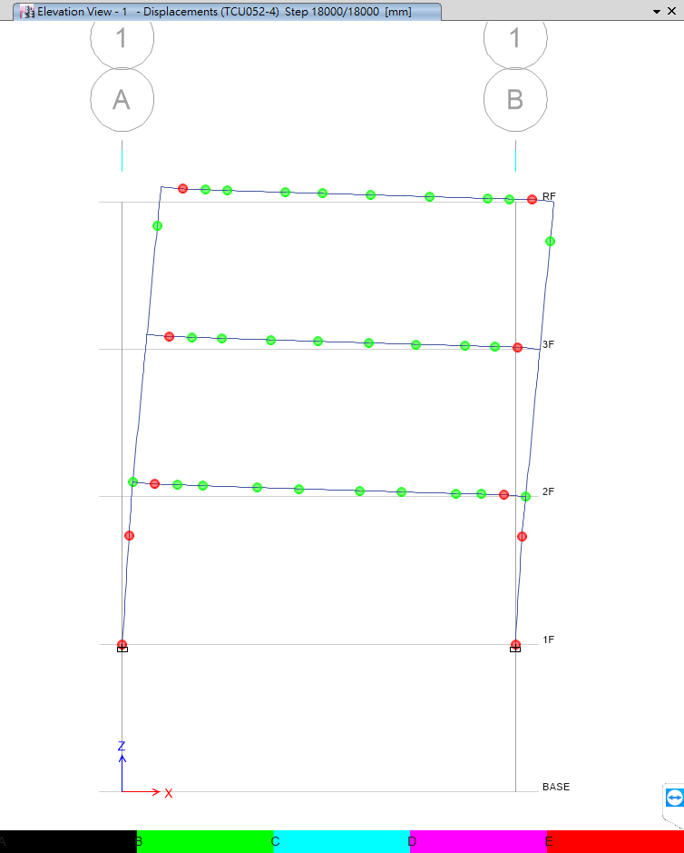
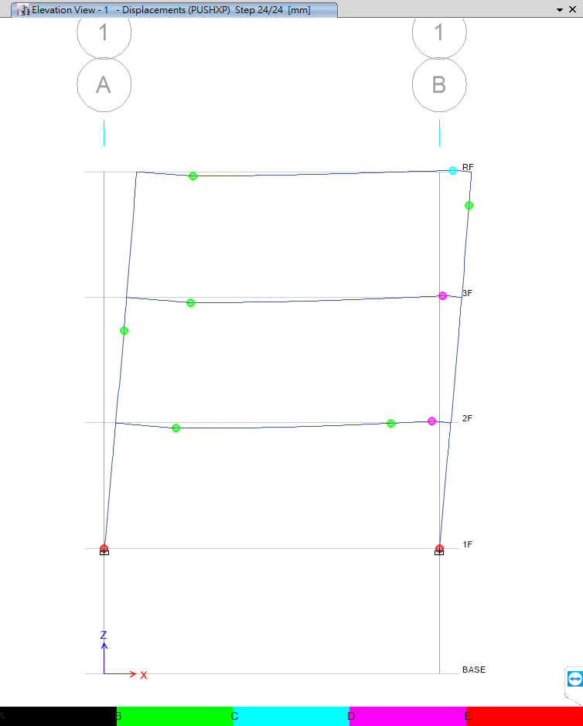
Beam Design
Time History
Pushover
No Middle Hinge

Slide 17
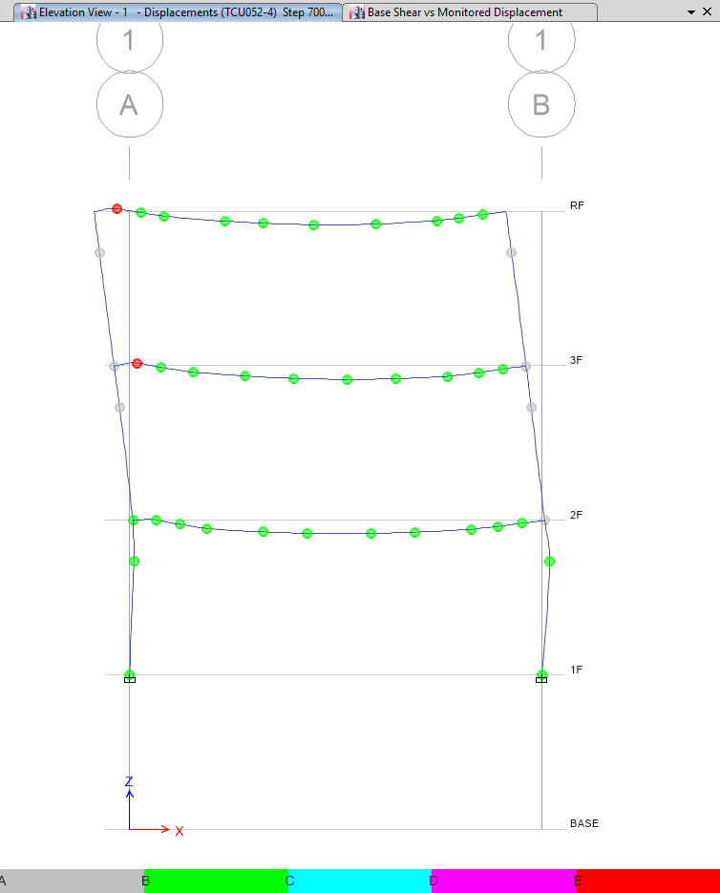
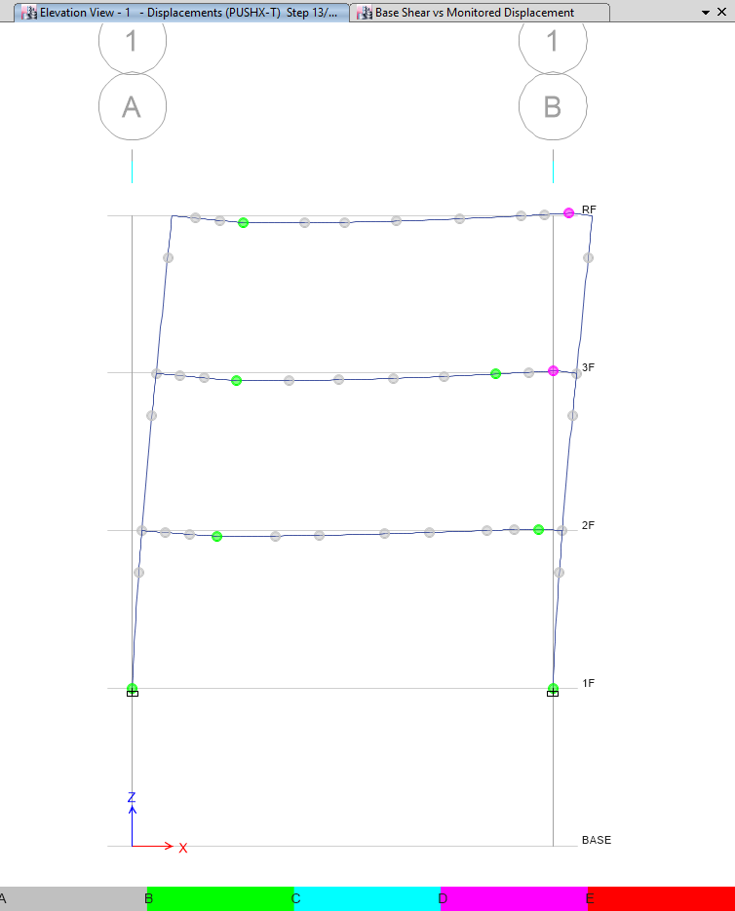
Strong Column Weak Beam
Time History
Pushover
No Middle Hinge

Slide 18
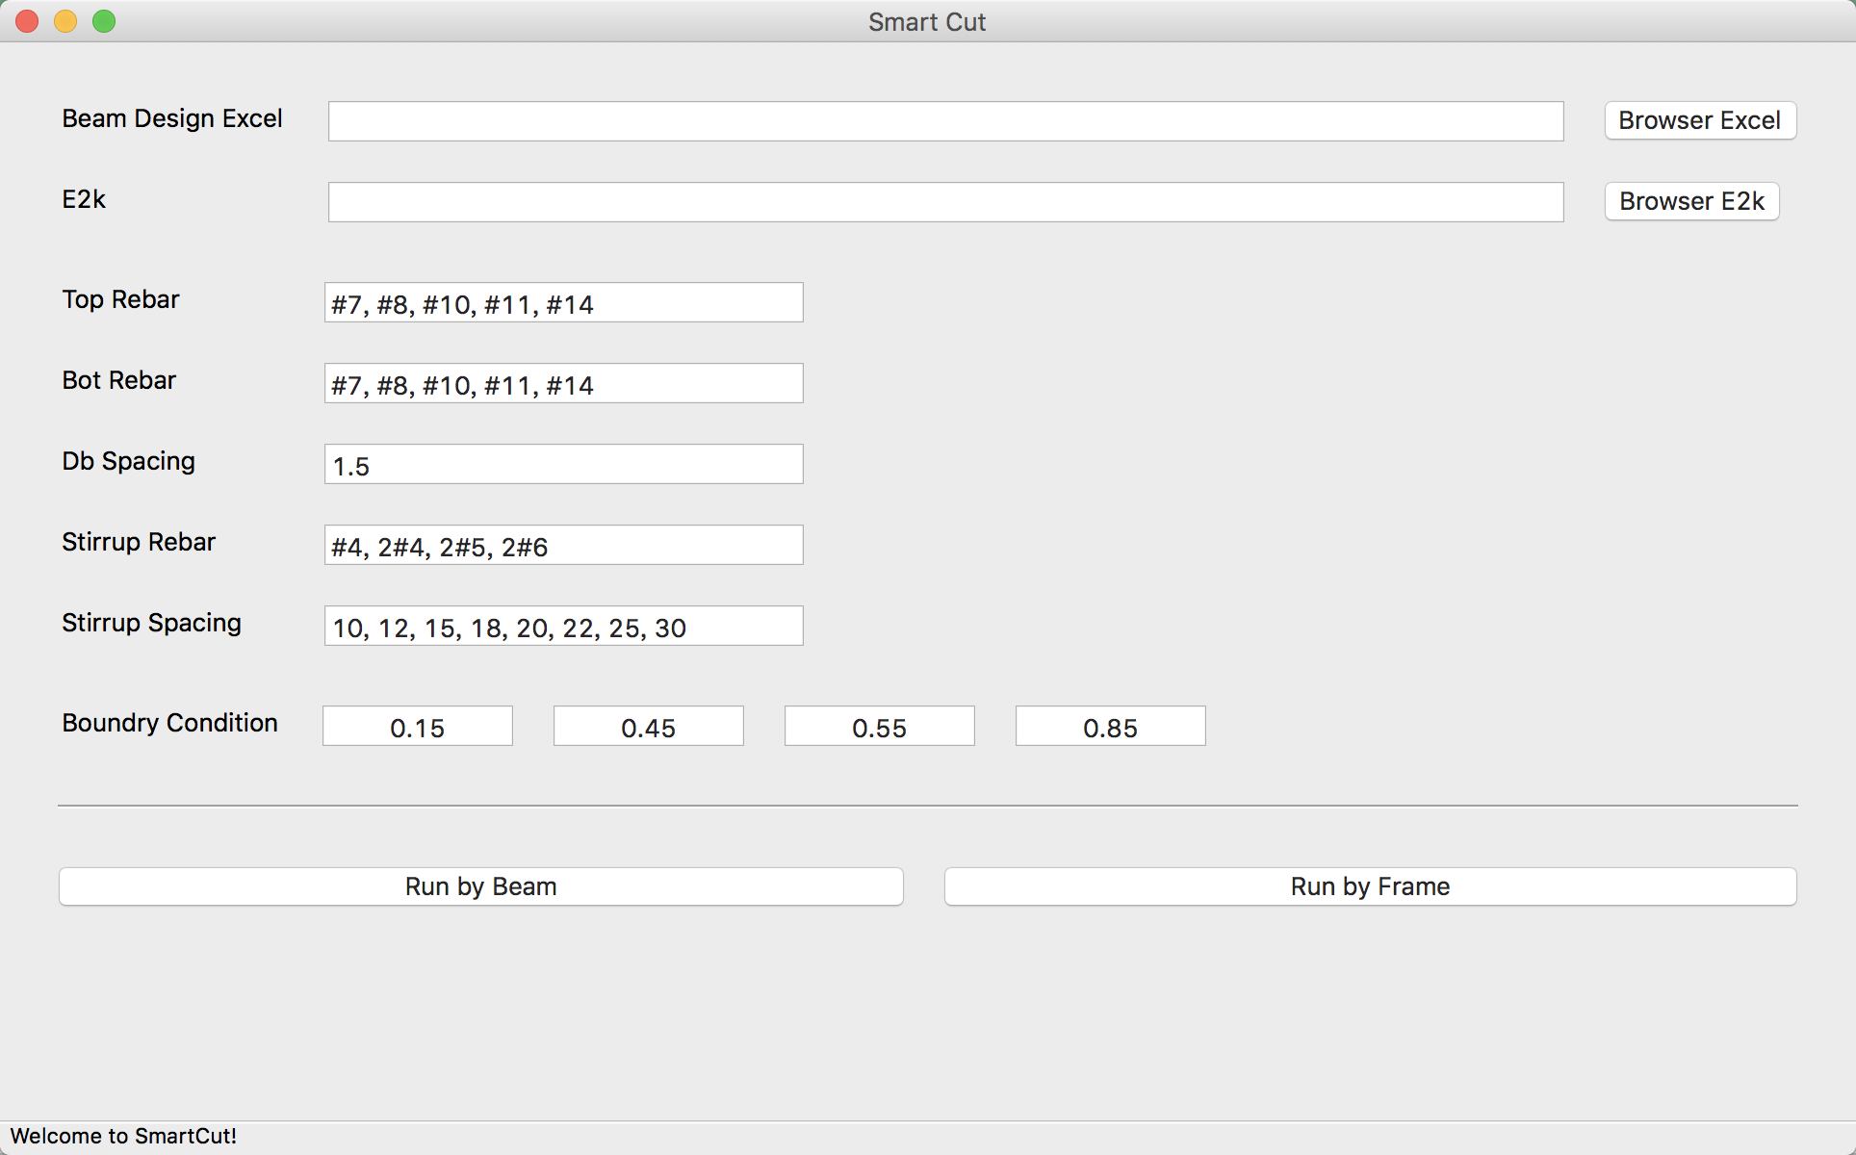
LinearCut
GUI

Slide 19
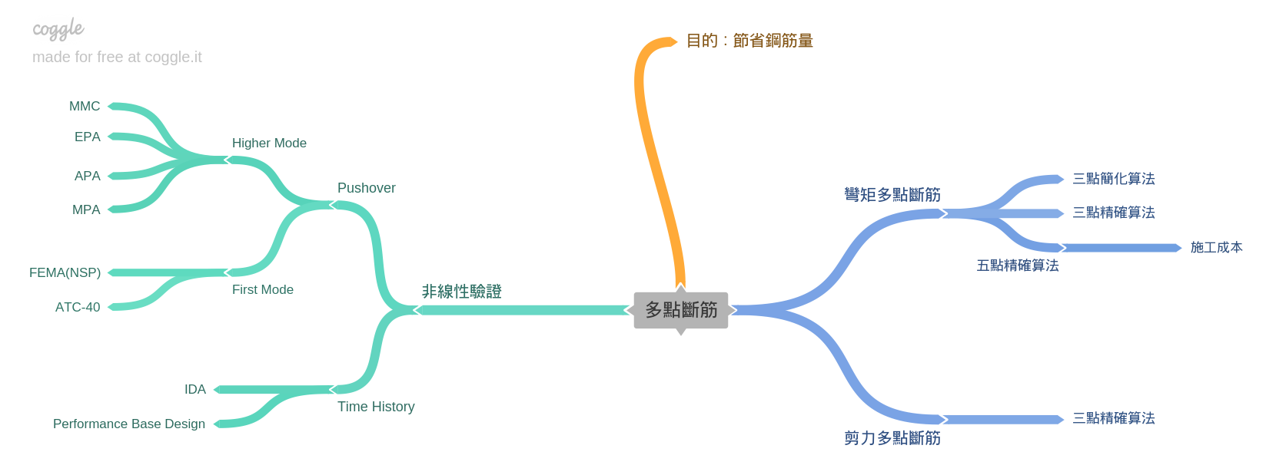
Roadmap
GUI
Nonlinear Hinge

